Slide 1
Class 7
Key Principles of Behavior Change

Slide 2
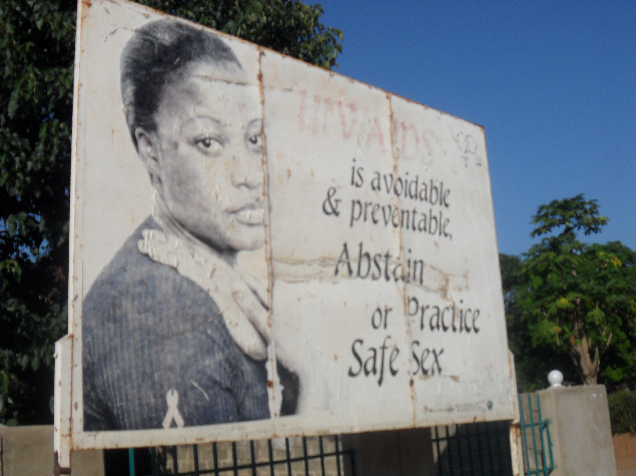

Slide 3
Change is dramatic.
But it is a result of a process not a single event.
For a pot to boil, you must increase the heat.

Slide 4
Behavior Change
Happens over time
Is a natural part of life, always full of drama
Different people respond differently

Slide 5
PRINCIPLE #1
Knowledge is necessary to change behavior.

Slide 6
Knowledge
Knowing what is good for you
Stopping the rot
Knowing where to look and find the benefits (Access)

Slide 7
Questions
Start with one question, answer another
Remember social factors
It’s not propaganda. So don’t beat people up with your ideas.
Know that there is a social and cultural context that affects people. Expect resistance.
Explain yourself

Slide 8
What do questions suggest?
People want information that they can use.
Information helps guide people in their decisions/actions.

Slide 9
PRINCIPLE #2
Knowledge is necessary but it is not enough to change behavior.

Slide 10
I know BUT…
I know I drink too much BUT… I need time to relax away from home
I know my child needs to go to school BUT… what is the point if there are no jobs?
What will my neighbours/ family say?

Slide 11
PRINCIPLE #3
Human behavior, and thus behavior change, is influenced by many factors.

Slide 12
Building Blocks of Change
When factors make it hard to change behavior we call them Barriers
When they make it easier to change behavior we call them Facilitators

Slide 13
Behavior Change in Context
Many factors influence behavior
Environmental
Social
Personal

Slide 14
Personal Influences
Information - What’s the problem?
Risk perception - What’s it got to do with me?
Skills - Do I have what it takes?
Confidence - Will I succeed?
Expected Results - What will happen if I do this?

Slide 15
Social and Environmental Influences
Interpersonal relationships
  Sex partners, family, friends, health care workers, counselors
Media, Culture, Legislation, Service Availability

Slide 16
Influencing behavior means addressing the context of behavior change at every level.

Slide 17
What do barriers & facilitators sound/look like?
Barrier to nourishment in family:
  I plant a cash crop
Facilitator:
  My child is ill

Slide 18
PRINCIPLE #4
Change is a process.

Slide 19
Behavior Change is a Process:
Stages of Change
Not thinking
Taking Steps
Thinking
Changing

Slide 20
I can’t / I won’t
I may
I will
I have
I am
T H I N K I N G
&
F E E L I N G
D O I N G

Slide 21
Precontemplation
Contemplation
Preparation
Maintenance
Action
setback
setback

Slide 22
PRINCIPLE #5
People learn by observing others.

Slide 23
Role Models
Who are your role models?
What are their qualities?
How and why do you identify with them?
Do you think you can become like them?
How would you become like them?

Slide 24
Who are Role Models?
People we know
Celebrities
Fictional/media characters

Slide 25
Key Factors for Behavioral Models
Similarity
Aspiration
Identification
Competence
Credibility
Empathy

Slide 26
Role Models
Educate
Persuade
Motivate
Enhance Confidence

Slide 27
Key Principles of BC
People need information to motivate change
People need more than information to motivate change
BC is influenced by many factors & occurs in context
BC is a process, not an event
People learn by observing others

Slide 28
Modeling Behavior Change
Through Storytelling

Slide 29
Why Stories?
Storytelling is intuitive, traditional
People process information more easily and effectively through stories
Cross cutting
Thematically
Media platform
Characters can’t let you down
Story context = life context = Life & Death
Storytelling is food – a foundation for who you are

Slide 31


Slide 32
Media can…
Stimulate dialogue & widen debate
Provide platform for voices to be heard
Provide accurate information
Provide positive images & role models
Encourage action
Create supportive environment
Capture attention
Build capacity through partnerships

Slide 33
How do we model behavior change?
Stories with characters who:
are similar and empathetic and inspire the listener
go through the process of behavior change
use facilitators to overcome barriers
Experience upliftment/ progress

Slide 34
Character Types
Positive
Negative
Transitional

Slide 35
Thank you.

