Slide 1
Class 6
Modeling Behavior Change - Through Storytelling
Notes:
Modeling is a term used in Behaviour Change to show how a character in a drama acts as a model for a particular type of behaviour.
A transitional character “models” the the desired change, moving from a negative type of behaviour to the desired behaviour.
Change is a process. A transitional character would ‘model’ that process of change.

Slide 2
Why Stories
Storytelling is intuitive, traditional
People process information more easily and effectively through stories
Cross cutting
  Thematically
  Media platform
Characters can’t let you down
Story context = life context
  Love, tragedy, struggle, triumph

Slide 3

Notes:
Just telling people what to do won’t necessarily change them

Slide 4
Media can…
Stimulate dialogue
Provide platform for voices to be heard
Provide accurate information
Provide positive images & role models
Encourage action
Create supportive environment
Capture attention
Build capacity through partnerships

Slide 5
How do we model behavior change?
By telling stories with characters who:
are similar to and inspire the audience
go through the process of behavior change
use facilitators to overcome barriers
Experience appropriate outcomes

Slide 6
These stories have characters that are:
Culturally similar to the target audience
That audience relates to, emotionally connects to, and identifies with...
Has similar needs/wants, skills/abilities.
Demographically similar (gender, age, ethnicity, language, etc.)
Confronts realistic barriers and obstacles.

Slide 7
How serial dramas appeal
Builds on an intuitive tradition
Captures audience attention
Keeps audience attention over time
Appeals to a diverse audience
Emotionally compelling
Audience relates to characters and stories
Shows issues in realistic context

Slide 8
Modeling in serialized format
Benefits
Increase identification with character
Audience continuity and engagement
Greater entertainment potential
Realism
Notes:
The serial drama is a very big opportunity to develop characters that go through a process of change over time.
They are pushed along, up and down, by the influences (barriers and facilitators) that act on them.

Slide 9
Terminology
Behavior Change Objective = A character’s (story’s) behavior change goal.
Behavioral Trajectory = A character’s path/story of change with timeline.
Stages of Change (SOC)= the different steps a character goes through in their process of change
Notes:
The trajectory can also be referred to as the arc – the dramatic arc of a character

Slide 10
Behaviour Change Objectives (BCO)
Not all characters change
Characters that go through a process of change are TRANSITIONAL CHARACTERS
In story, we define their BCO:
  To participate actively in politics
  To access ante-natal care
  To share decision-making with a spouse on household income

Slide 11
Stages of Change - the process of change
Precontemplation = Not thinking of changing (I can’t, I won’t, I don’t know)
Contemplation = Thinking about change (I may)
Preparation = Starting to take some steps towards change (I will)
Action = Making the change (I am)
Maintenance = Made the change (I have)

Slide 12
The stories tell us what is, what could be, and what should be.
Notes:
With Behaviour Change Drama you want to develop characters that go beyond just being passive ‘victims’ of social circumstances.
In BC drama, characters tend to overcome adversity… move towards healing... Or some better life...
In other word, they reap benefits from the change.

Slide 13
Why Stories?
Storytelling is intuitive, traditional
People process information more easily and effectively through stories
Address many issues
Characters can’t let you down
Story context = life context
  Love, tragedy, struggle, triumph

Slide 14
Stories that model change have characters who:
are similar to and inspire the audience
go through the process of behavior change
use facilitators to overcome barriers
Experience appropriate outcomes

Slide 15
How people relate to characters
Emotional connection
Identify with characters
Notes:
Identify with characters… often means just getting under the skin of the character that is going through difficult change, so that audiences get behind that character and yearn for the change to happen

Slide 16
Similarity and Aspiration
Emotional connection
Identify Culturally
needs/wants
skills/abilities
gender, age
ethnicity, language
Face realistic barriers and obstacles
Something else…
characters
“Make me the best me I can be”
Notes:
Often this is, from an audience point of view, “somebody like me…”
“I understand where this character is coming from...”

Slide 17
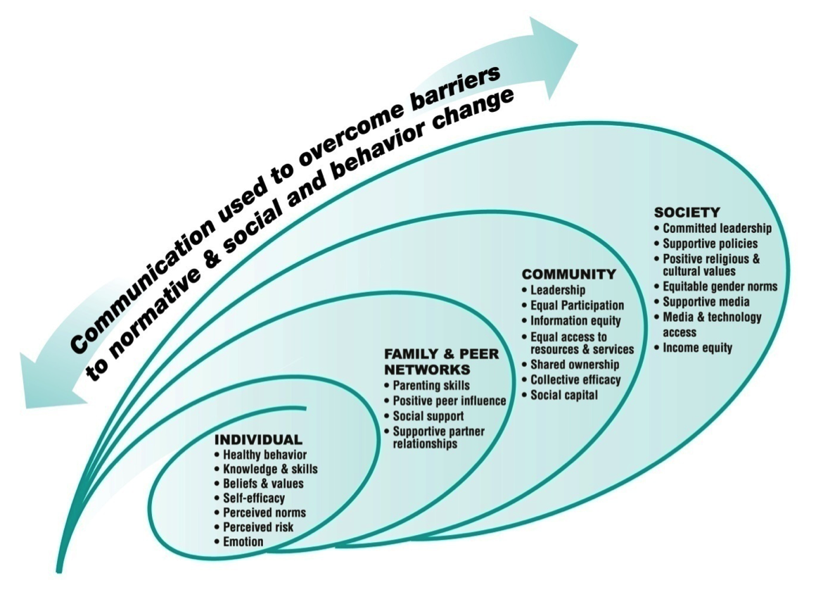
Influences on Individuals

Slide 18
Individual Influences
Information - What’s the problem?
Risk perception - What’s it got to do with me?
Skills - Do I have what it takes?
Confidence - Will I succeed?
Expected Results - What will happen if I do this?
Notes:
Information – Individuals knowledge and understanding of the problem may only be partial at first. Their understanding and knowledge needs to improve…
Risk – Often individuals don’t really see how a certain behavioiur could be wrong, or they justify it as ‘the norm’
Skills – this is a feeling about oneself and relates to education, or self-belief or just the ability, at a personal level, to make changes. If a character isn’t equipped to change, the change won’t happen... Something or some influence has to help the character move...
Expected Results – also known as ‘outcome expectation’ – If the expectation is negative… “I’ll never be able to do this...” then change won’t happen. When the feeling changes to, “You know I might just be able to...” that is progress.

Slide 19
Social and Community Influences
Interpersonal relationships
  Sex partners, family, friends, the fabric of people that impact on an individual
  Community leaders, faith leaders and influencers, significant figures in the community
  Ideas and norms

Slide 20
Societal Influences
Media, Culture
Infrastructure
Legislation & policy
Service Availability and access
Religion, faith
Notes:
These are influences that tend to be fixed, like the stars

Slide 21
Applying Barriers & Facilitators to Characters
For each character ask…
Where did each B/F come from?
How does my character experience this?
How, specifically, does my character respond to this?
How are the B/F influencing my character’s movement through the story (SOC)?
How does the audience know this is happening?
Notes:
The Barriers and Facilitators are the building blocks of any BC story. They are ‘visible’ to the creator of the drama, but seem natural and seamless to the audience

Slide 22
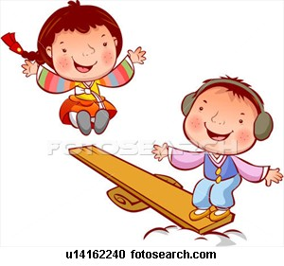
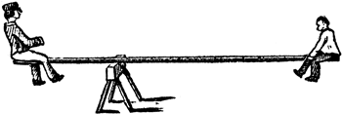
Decisional Balance
Tipping Point
Notes:
Characters only change when there is enough compelling reason to change.
In drama, it’s no good if a character changes rather suddenly for not very convincing reasons. The reasons need to be powerful and compelling. The reasons for change build up like rain clouds until change is precipitated.

Slide 23
I can’t / I won’t
I may
I will
I have
I am
T H I N K I N G
&
F E E L I N G
D O I N G
Notes:
Self explanatory – this is how characters move over time towards making the change…

Slide 24
Precontemplation
Contemplation
Preparation
Maintenance
Action
setback
setback
Notes:
In drama, it is the setbacks that often are the most dramatic. It is the setbacks often that inspire change.
A setback tends to be something unrelated to the actual Behaviour Change. For example, a character is about to make a change but something happens to stop them – there is a massive storm, the bus breaks down, a visitor arrives, another child is sick… something that requires a delay in achieving the change.

Slide 25
Path of Change/Behavioral Trajectory
Where does my character start? Why does he/she start there?
Where does my character end up? How?
What influences my character along the way (B/F)? How?
How long does it take?
Notes:
Generally, transitional characters on a journey of change start in a negative place and end in a positive place. So for example, a woman who was not able to have any discussion with her husband about how household income is spent, by the end of the drama, has a conversation and is able to influence how household income is spent (for the betterment of the family etc)

Slide 26
Character Types
Positive
Negative
Transitional
Notes:
The transitional character – or character going from a negative place to a positive place – is influenced by negative characters and positive ones.
You can have really appealing and exciting negative characters, by the way.
The positive character type refers not to a sunny and pleasant personality, but to a character that somehow models the behaviour you want to change
The negative character may be exciting and so on but he/she will not get the benefits of change. They will be stuck with their negative ways.

Slide 27
Makgabaneng Contrast Models
Mary
Uses sex to get things
Falls pregnant - several possible fathers
Delays testing for HIV
Tests HIV+ but refuses to enroll in PMTCT
Baby (Hope) born HIV +
Not adherent to infant feeding guidelines
Hope dies.
Masego
Average young woman, likes to have fun
Falls pregnant through date rape
Encouraged by nurse and friend to test, tests HIV+
Encouraged by nurse and friend, enrolls in PMTCT
Baby born HIV -ve
Complies with infant feeding guidelines - baby survives
Notes:
Contrast modelling is showing how two characters go in different directions.
The transitional character gets to the desired behaviour – and rewards and benefits – in the end. The negative character has the same old, same old.
Often through contrast you are able to illuminate how the desired behaviour brings rewards for the character adopting the behaviour and ends badly for the person that doesn’t.
So, you have to have Behaviour Objectives that are realisable in the social context. They have to be credible and desirable changes.

Slide 28
Role models
Provide information on how to change
Change perceptions of the barriers and facilitators of a behavior & what to expect
Enhance audience confidence in their ability to learn a certain behavior
Express thoughts and feelings about change and cope with setbacks
Create an emotional stake in changing behavior
Notes:
Obviously these are people who have ‘been there and done that’. They have experienced the change.
You can get negative as well as positive role models of course.

Slide 29
Showing how people change
The story/characters feel familiar/similar to the audience
Shows that change may be difficult, but that obstacles can be overcome
Reinforces that behavior change is a process and takes time
Demonstrates steps related to BC
Experience appropriate outcomes
Notes:
The important thing is to have a transitional character that has been able to effect change. It’s not enough to understand the problem. In BC drama, the transitional character after a lot of ups and downs, eventually achieves the change. For the better.

Slide 30
Thank you

