Slide 1
Class 6
MARCH Approach Example

Slide 2
Introduction
MARCH Historical Background
First MARCH project conducted by CARE Ethiopia 2001–2004 in 2 sites:
    (Oromia - West Hararege and Addis Ababa)
Modeling: Radio Serial Drama (RSD)
Reinforcement: Listening discussion groups (LDG)
Outcome evaluation demonstrated that exposure to intervention:
    improves knowledge on ways of avoiding HIV/AIDS
    increased self-efficacy of individuals to use condom
    improved individual’s perception of non-differential treatment of PLWHAs
    Increased positive outcome expectancy in relation to HIV testing
Notes:
MARCH Model developed by CDC Atlanta

Slide 3
Implementation Process
Data Summary Grid
Assessment findings were summarized and categorized as barriers or facilitators for behavioral change around specific topics
AAU*, NDFE, and FP:
KAPB on HIV/AIDS
Stigma and Discrimination
KAPB on condom
Sexual behavior and risk perception
HIV testing & exposure to interventions
*AAU: Abstinence and Faithfulness

Slide 4
Implementation Process
2) Modeling Activities
PSD Workshops
Script Production
Cartooning and Photography
Graphic Design
Post production

Slide 5
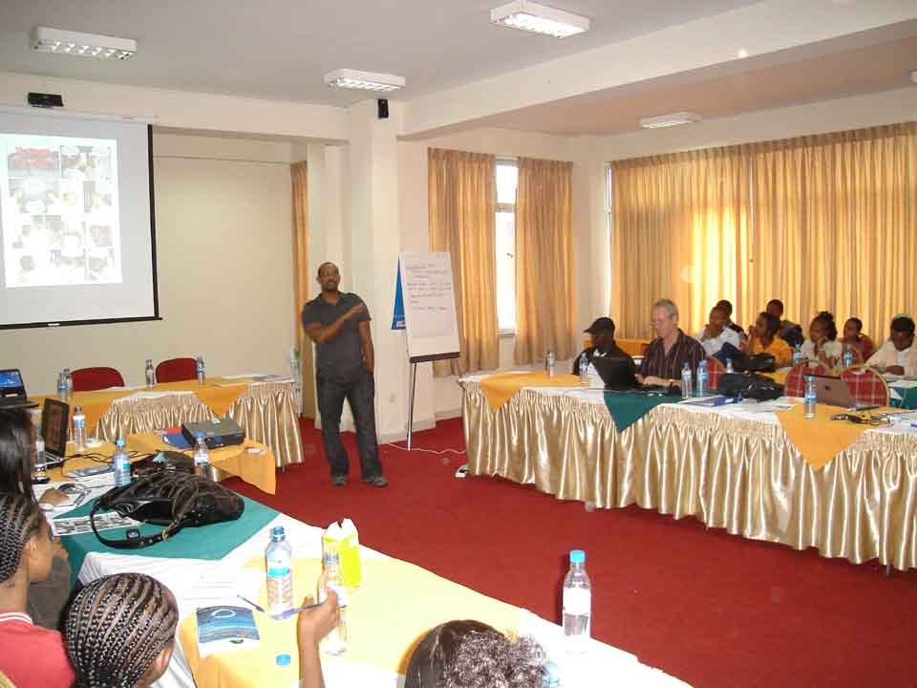
Modeling Activities
PSD Development Workshops were conducted for all three partners. Key outputs include:
Defined behavioral change objectives for each target community
Developed “bible ” for each partner – character profile, storylines, Pathways to Change exercise and charts, behavior change trajectories, coordinating charts
Scripts for 3 – 6 episodes, sketches
Choice made for cartooning or
photo comics
Capacity building of creative and
program staff

Slide 6
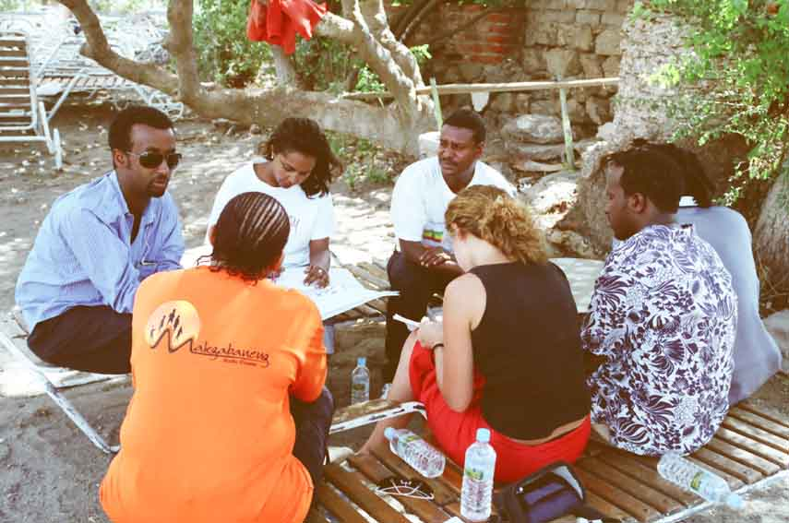
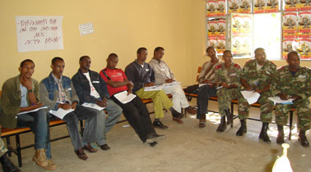
Modeling Activities
Behavior Change Objectives
NDFE and FP
Correct and consistent condom use
Faithfulness
VCT, ART and positive living
VCT, Support for PMTCT, + living
AAU
To explore sexuality in a safe, healthy, responsible and respectful way
To make safe/healthy, responsible decisions about sex and relationships
To have the self efficacy to live a productive and healthy life while dealing with the challenges of living with HIV
To achieve a long term, faithful and trusting relationship

Slide 7
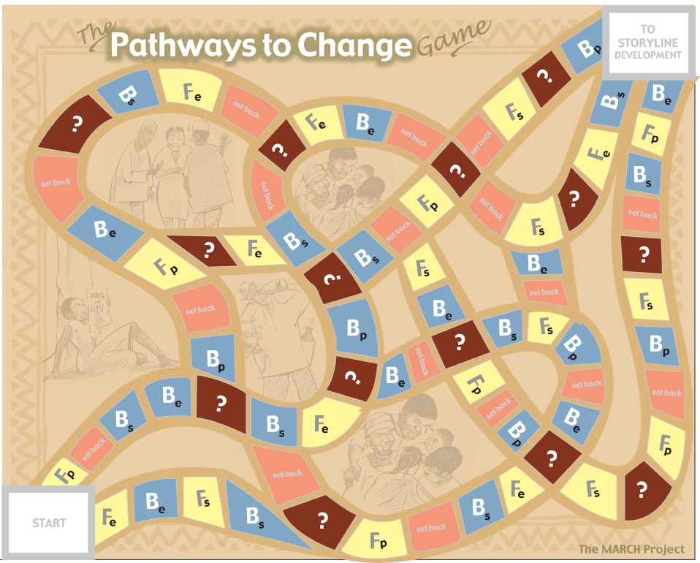
From Research to Drama
Pathways to Change Game

Slide 8
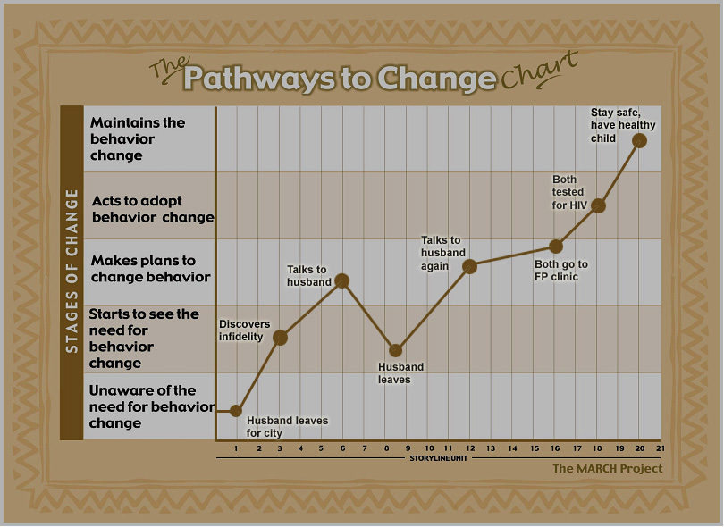
From Research to Drama
Pathways to Change Game

Slide 9
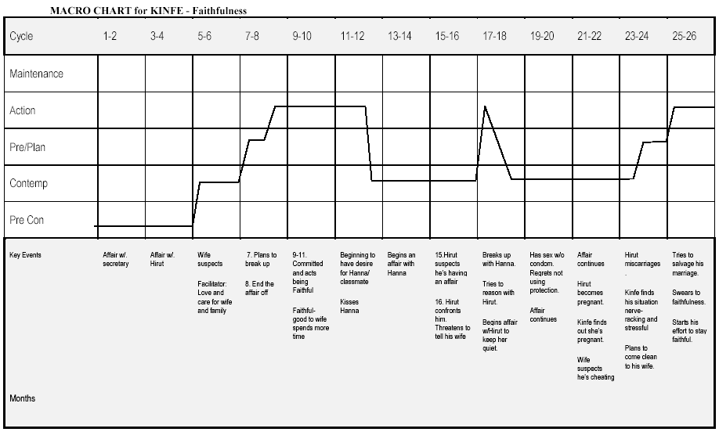
From Research to Drama
The MACRO Chart
Used to plot storylines in a theoretically consistent manner across time

Slide 10
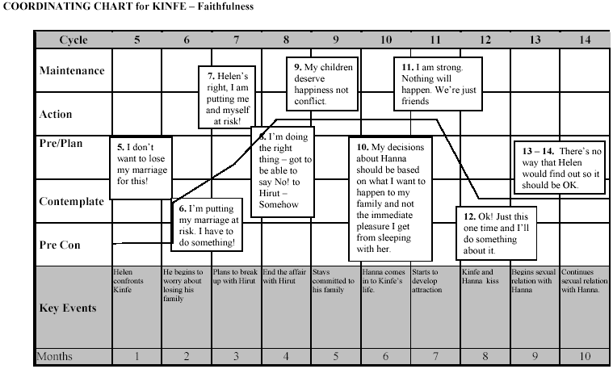
From Research to Drama
The MACRO Chart
The Coordinating Tool

Slide 11
The Production Process

Slide 12
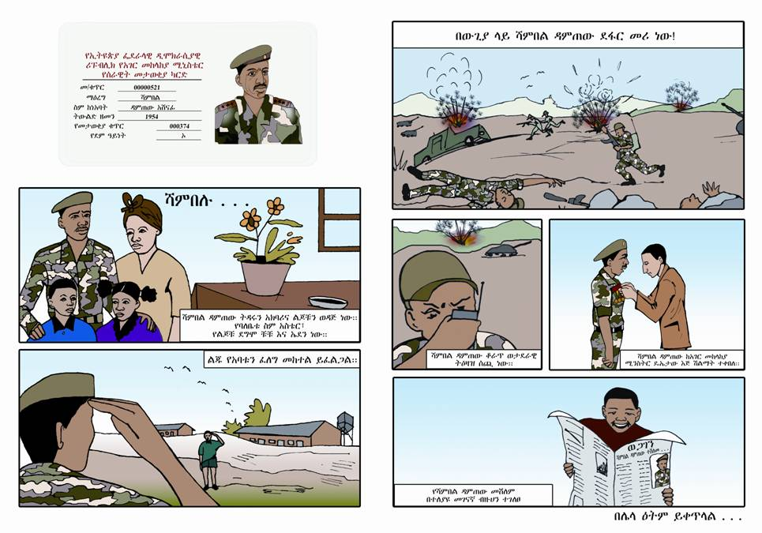
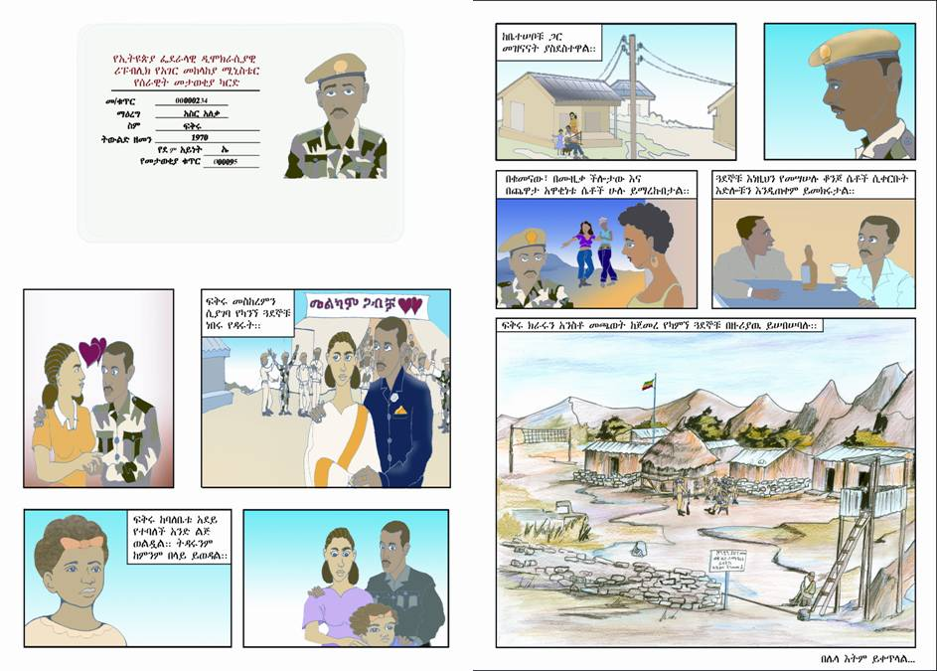
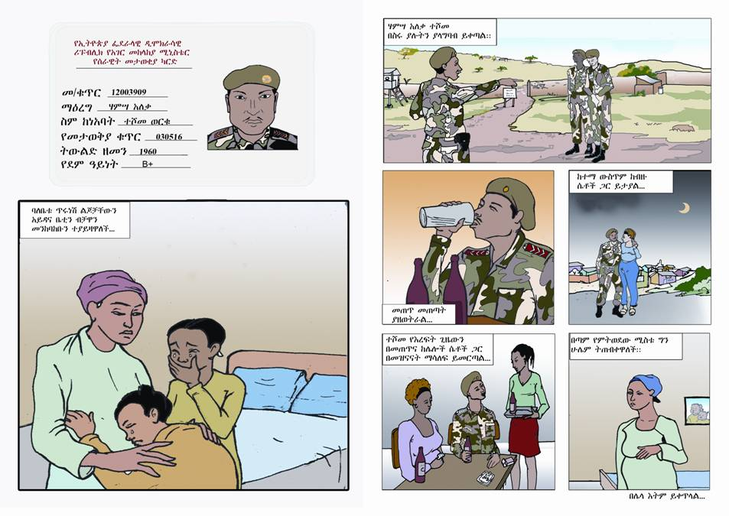
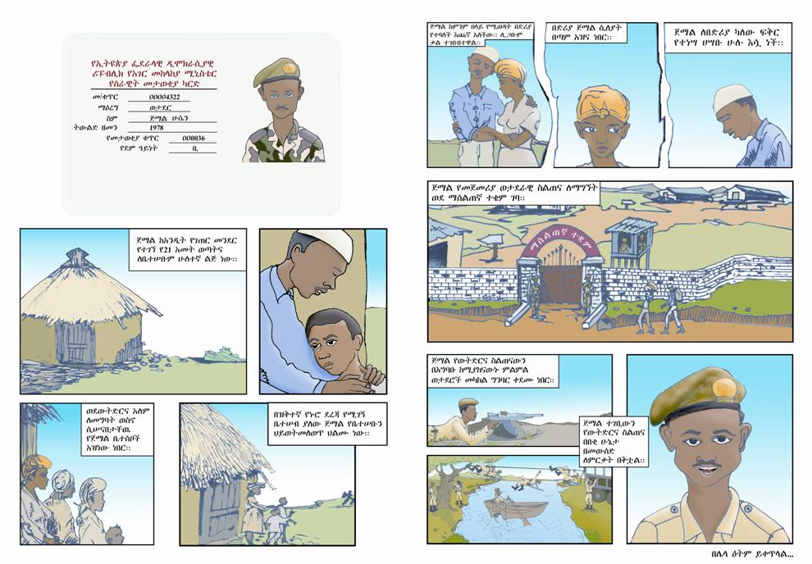
Modeling Activities
Character Profiles – NDFE “Black Tigers”

Slide 13
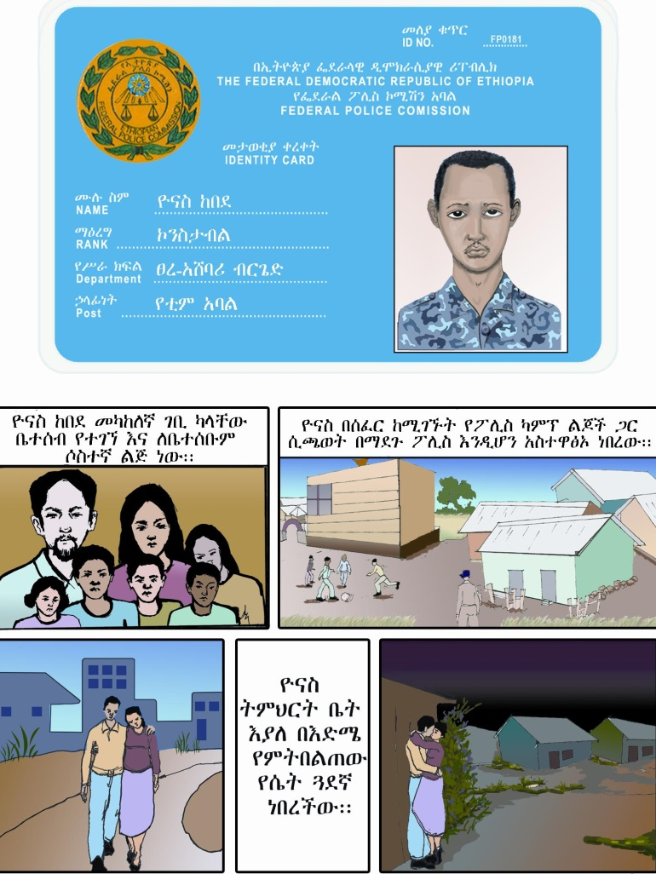
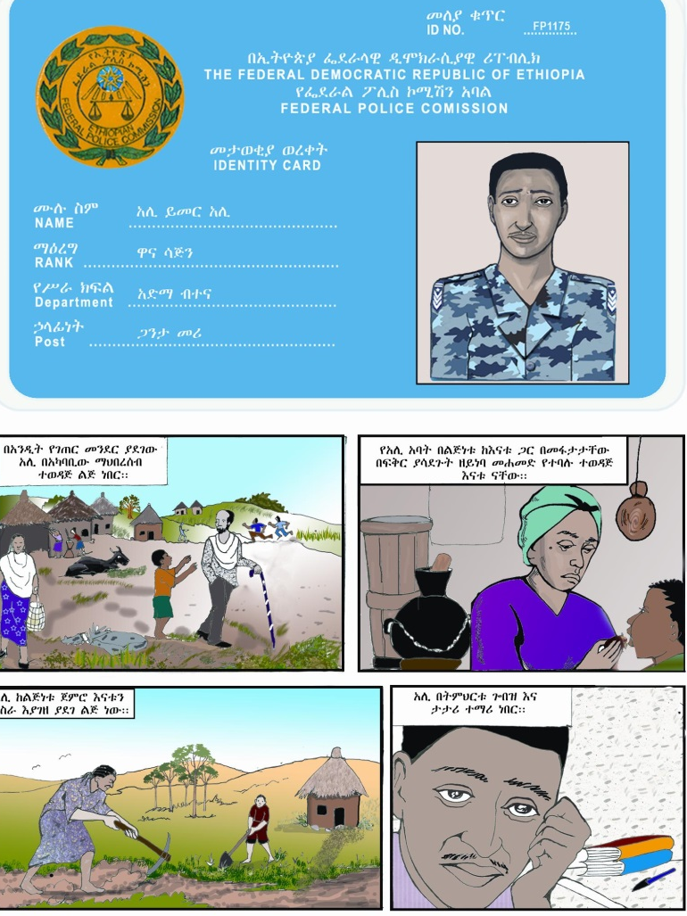
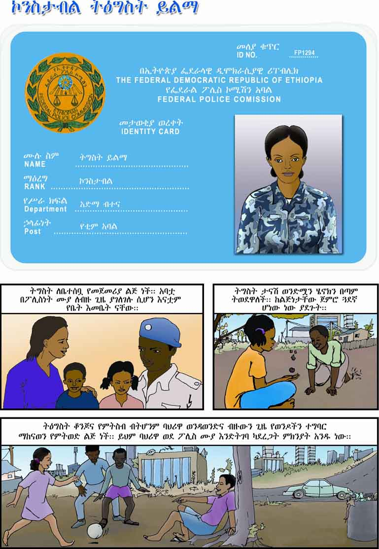
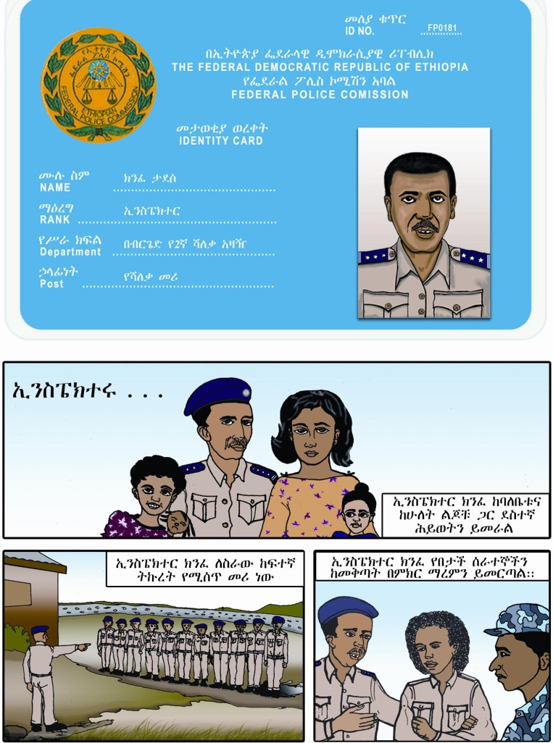
Modeling Activities
Character Profiles – FP “Shooting Stars”

Slide 14
Modeling Activities
Script Production (in chronological order)
Script writing by partner and CCP scriptwriters
Internal review and correction - weekly review meeting focuses on technical and peer creative review.
External review and correction – review by CCP technical staff, partners, CDC Ethiopia and CDC Atlanta within 5 day timeline.
Finalization of scripts is followed by development of discussion questions for each edition by MARCH program team.

Slide 15
Modeling Activities
Cartooning and Photography (in chronological order)
Cartoonists begin by reading scripts after the internal review and correction process
Pencil sketches are developed and reviewed with script writers
Sketches are finalized and then inked for coloring
For photo comics, pencil sketches are finalized as storyboards which guide the photo shooting

Slide 16
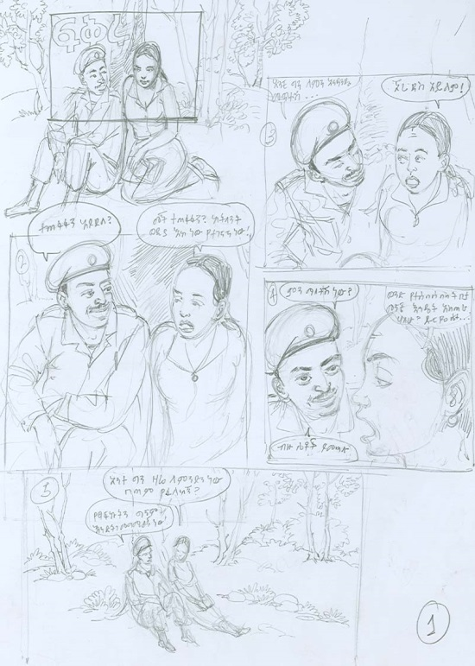
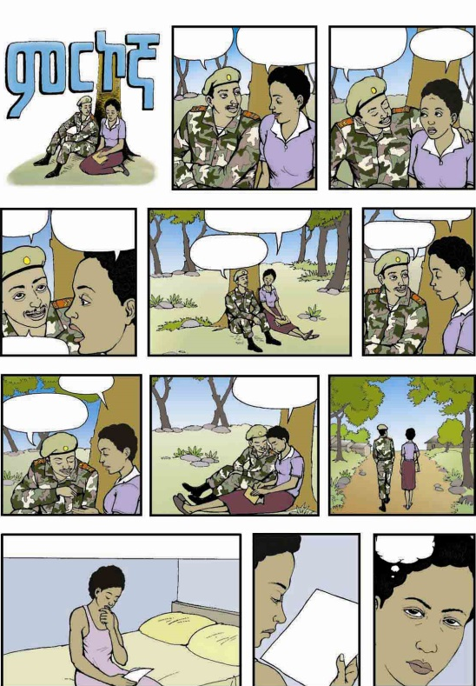
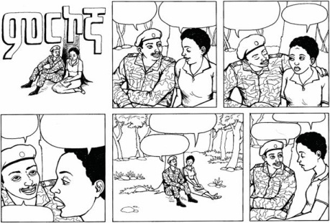
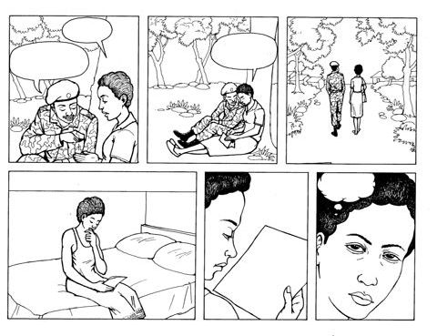
Modeling Activities
Cartooning Cont’d
Review & correction
Pencil Sketch
Coloring
Final inking

Slide 17
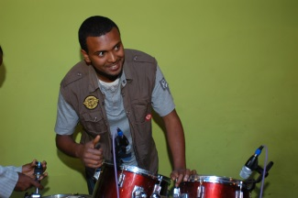
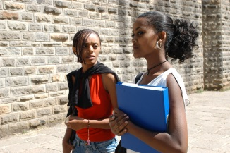
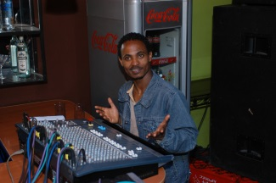
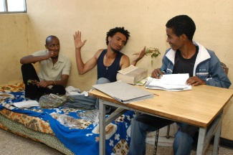
Modeling Activities – Comic Book
Photo comic production Cont’d
Shot list & story board for each scene in each storylines developed
Shot list developed
Photo layout
Text in bubbles
Photo shooting

