Slide 1
Class 6
Key Principles of Behavior Change

Slide 2
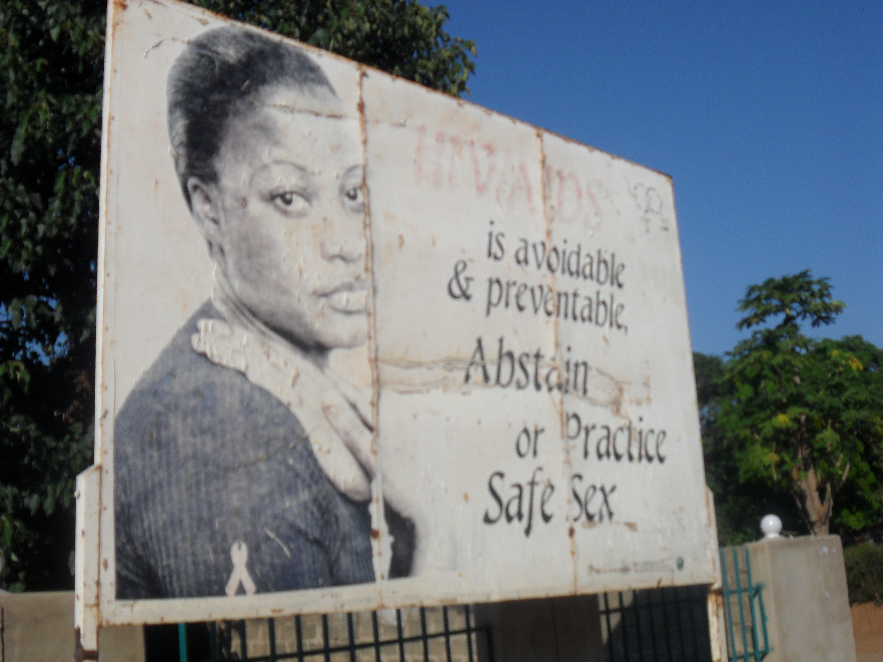
Notes:
Messaging is not enough.
You can tell people what to do but it might not make any difference.
People can take it or leave it. They can ignore it. They see it but do nothing about it.
Just because you know something doesn’t mean to say you will act on it.

Slide 3
A habit cannot be tossed out the window; it must be coaxed down the stairs… a step at a time
Notes:
It is rare that change is sudden and dramatic. More often it happens over time, through trial and error, ups and downs.
Change is generally a maturation process.

Slide 4
Behavior Change
Starting or stopping
One time vs. continuous
Smaller steps
Notes:
Generally a change of behaviour has its own timeline.
A Behaviour Change might be a good behaviour started, or a harmful and unhealthy behaviour stopped.
Change generally happens in increments until it the change is complete.

Slide 5
PRINCIPLE #1
Knowledge is necessary to change behavior.
Notes:
If you don’t know about or understand the benefits of a change, or you prefer to remain in the dark about it, change won’t happen.

Slide 6
Knowledge
Accurate knowledge of the risks
Prevention strategies
Availability of services
Notes:
Knowledge is especially important in, say, seeking the right health information or service, but it could apply in many areas of life.
Mainly when it comes to healthy practices, like say combating malaria, you would need to find out how malaria could be combated.
And then you would need to know how to get help or services…

Slide 7
How does information help?
People want information that they can use.
Information helps guide people in their decisions/actions.

Slide 8
PRINCIPLE #2
Knowledge is necessary but it is not enough to change behavior.

Slide 9
I know BUT…
I know smoking is bad for me BUT…
I know I should vote BUT… (I doubt one vote would make a difference)
I know I should go to the hospital for a check up BUT… it’s far… my husband says, No... I have chores...

Slide 10
PRINCIPLE #3
Human behavior, and thus behavior change, is influenced by many factors.
Notes:
Just because you went to one lecture on Business Administration doesn’t mean you are equipped to start a business yet. A number of other factors would come into play.

Slide 11
Building Blocks of Change
When factors make it hard to change behavior we call them Barriers
When they make it easier to change behavior we call them Facilitators
Notes:
Barriers and Facilitators are the building blocks of story. They drive the

Slide 12
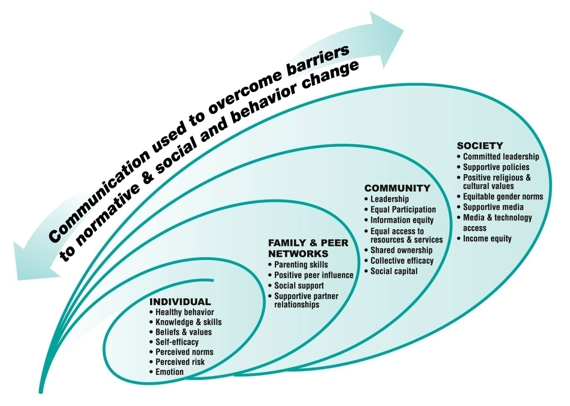
Behavior Change in Context
Notes:
Many factors influence behaviour – at the personal level relating to an individual’s sense of self worth, confidence etc; at the social level depending on family and friends’ opinions. Sometimes the risks of stepping out of line are high. Too high.
And at the societal level there may be immovable social constructs at play.

Slide 13
Individual Influences
Information - What’s the problem?
Risk perception - What’s it got to do with me?
Skills - Do I have what it takes?
Confidence - Will I succeed?
Expected Results - What will happen if I do this?
Notes:
Information – Individuals knowledge and understanding of the problem may only be partial at first. Their understanding and knowledge needs to improve…
Risk – Often individuals don’t really see how a certain behavioiur could be wrong, or they justify it as ‘the norm’
Skills – this is a feeling about oneself and relates to education, or self-belief or just the ability, at a personal level, to make changes. If a character isn’t equipped to change, the change won’t happen... Something or some influence has to help the character move...
Expected Results – also known as ‘outcome expectation’ – If the expectation is negative… “I’ll never be able to do this...” then change won’t happen. When the feeling changes to, “You know I might just be able to...” that is progress.

Slide 14
Social and Community Influences
Interpersonal relationships
  Sex partners, family, friends, the fabric of people that impact on an individual
  Community leaders, faith leaders and influencers, significant figures in the community
  Ideas and norms

Slide 15
Societal Influences
Media, Culture
Infrastructure
Legislation & policy
Service Availability and access
Religion, faith
Notes:
These are influences that tend to be fixed, like the stars

Slide 16
PRINCIPLE #4
Change is a process.

Slide 17
Influencing behavior means addressing the context of behavior change at every stage of the process.
Notes:
The individual

Slide 18
Barriers & facilitators to Individual process of change
An example of a Barrier to political participation
  Women are expected to stay at home
An example of a Facilitator to political participation in :
  The woman may join a women’s group that is already involved in local community affairs

Slide 19
Behavior Change is a Process:
Stages of Change
Not thinking
Taking Steps
Thinking
Changing

Slide 20
PRINCIPLE #5
People learn by observing others.

Slide 21
Role Models
I have 2 role models: my aunt and Oprah Winfrey. I’ve lived with my aunt for over 10 years, even though both my parents are alive. She raised me. She gives me guidance, and shows me what’s wrong and what’s right. Oprah is just good.
I also have two role models: Beyonce and my mom. Beyonce is just something else: down to earth, you never hear rumors about her, she doesn’t do bad things - she is so human that I really love her. My mother is my god…
My mother-- she raised me by herself-- and Michael Jackson.
Notes:
Role models play a huge part in what we aspire to…

Slide 22
Who are Role Models?
People we know
Celebrities
Fictional/media characters

Slide 23
Key Factors for Behavioral Models
Similarity
Aspiration
Competence
Credibility

Slide 24
Role Models
Educate
Persuade
Motivate
Enhance Confidence

Slide 25
Key Principles of BC
People need information to motivate change
People need more than information to motivate change
BC is influenced by many factors & occurs in context
BC is a process, not an event
People learn by observing others

Slide 26
Thank you.

