Slide 1
Class 4
Audience Segmentation - Dividing and organizing an audience into groups who have similar communication needs, preferences, and character

Slide 2
Audience Segmentation
Dividing and organizing an audience into groups who have similar communication needs, preferences, and character

Slide 3
Why segment audiences?
Limited resources may not allow us to reach everyone
Choice between reach and intensity
Different people may have different information needs

Slide 4
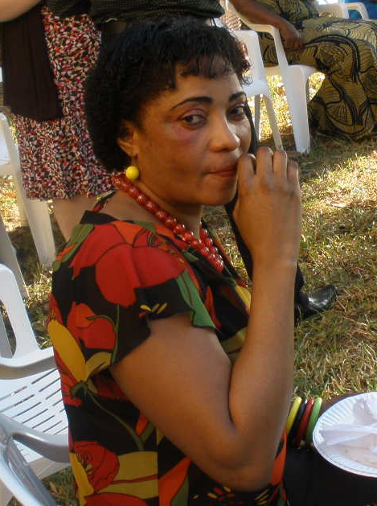
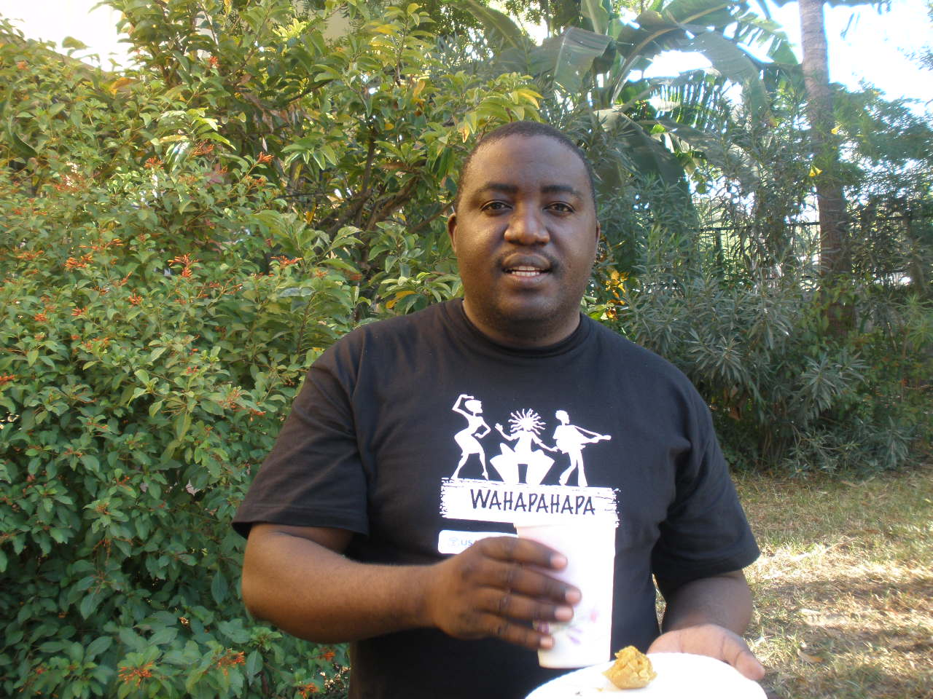
Main Idea
To communicate effectively, we need to put ourselves in our audience’s shoes and see things from their point of view.

Slide 5
Know your audience
Put yourself in your audience’s shoes

Slide 6
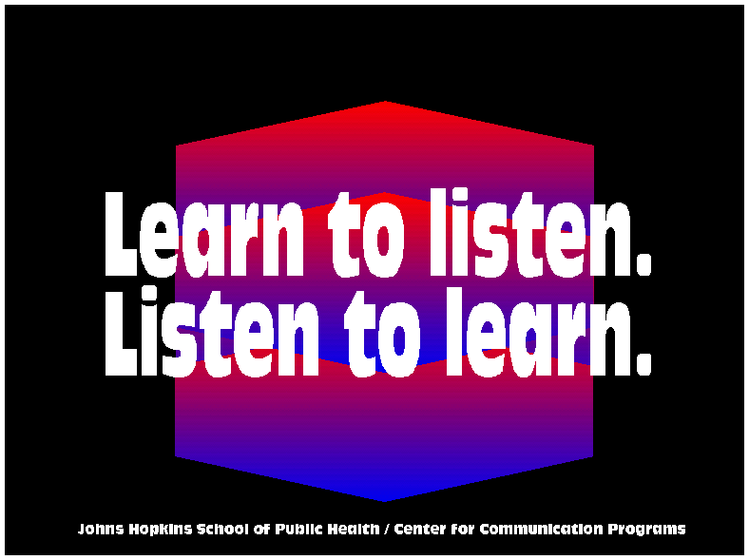

Slide 7

Different information needs
“One size may not fit all!”
A single campaign may not meet everyone’s needs.

Slide 8
Effective Communicators
Identify clearly the specific audience segments that they aim to reach
Seek to understand what their audiences know, feel and do

Slide 9
Conventional Segmentation
Socioeconomic
  Gender
  Age
  Income
  Education
  Religion
  Urban-rural residence

Slide 10
Conventional Segmentation
Social-Geographical Units
  Political units
  Towns/Cities
  Provinces/Districts
  Regions
Language groups
Ethnic groups

Slide 11
Media Behavior
Access to media
Media habits

Slide 12
Planning is always a learning experience
We may not always have all the data that we need.
We need to be aware of our own stereotypes.
It is okay to do something and then “learn”.

Slide 13
What we need to unlearn
Health is for all and everyone should behave the same way.
Everyone has the same information needs.
People who behave in the same way have the same motivations.

Slide 14
Alternative thinking
Health is for all but there are many paths to better health.
People may have different information needs.
Similarity of behaviour does not imply similarity of motivation.

Slide 15
Creative Brief
Technical information that the writers and producers will need to create a successful EE program is put into a Creative Brief

Slide 16
Importance of Creative Brief
Audience
Review Team
Directors & Actors
Script Writers
Creative Brief

Slide 17
Sources of Information?
Formative Knowledge, Attitudes Practices (KAP) Research
Qualitative research
Media surveys
Sociology
Media analysis
Field visits with audience or stakeholders
Notes:
Remember the A-train.
Don’t do the design till you have an understanding of the audience through research - even with a few in the workshop,

Slide 18
Creative Brief Contents
Overall Communication Goal
Clarify the problem
Identify key primary and secondary audiences and profile (geographic, economic, social race, religion, age, sex, lifestyles, media habits, etc.)
Identify potential desired behaviors
List barriers and facilitators
Call to Action
Notes:
Main topics
Number of programs devoted to each topic
Order in which main topics will appear: (Sequential or spread out through the series)
Design team members - choose carefully

Slide 19
1. Communication Goal
Clarify what the overall goal of the program is
Notes:
My suggestion is that you walk through each of these steps of the creative brief using the Family Planning example included in the file folder so that they can see an example.

Slide 20
2. Problem Statement
Include situation analysis
What is the issue/behavior you wish to change and why it should be changed
Why EE and the chosen medium is an appropriate approach to reach your audience
Notes:
Very important for donors and governments. TV or video is relatively expensive, so need to have a good justification.
In the workshop - you would present the research and get feedback and use that information as part of your document. You may have the group do a bit of further analysis on what you’re presenting (will share later with SUMATA)
In order to justify medium you need media survey data - this can be found from DHSs or government surveys or sometimes from the private sector.

Slide 21
3. Audience Segmentation
Primary
Secondary
Notes:
We know that the more specific the audience, the more likely to have an effective program. Age, urban rural, socioeconomic, etc
Always a huge debate.
Programs that work for one audience won’t work for another.

Slide 22
Audience Profile
Psychographic and Demographic
geographic, economic, social,
age, gender, literacy
current knowledge attitudes and practices
media habits

Slide 23
4. Identify potential desired behavior
Explain a few key desired behaviors that the audience will achieve after watching the program.
Notes:
We know that the more specific the audience, the more likely to have an effective program. Age, urban rural, socioeconomic, etc
Always a huge debate.
Programs that work for one audience won’t work for another.

Slide 24
5. List barriers and facilitators
Identify barriers that keep the audience from doing the behaviors
Identify facilitators (ie. people, aspirations)that will inspire audience members to practice the behavior
Notes:
We know that the more specific the audience, the more likely to have an effective program. Age, urban rural, socioeconomic, etc
Always a huge debate.
Programs that work for one audience won’t work for another.

Slide 25
6. Call to Action
What the audience can do that will contribute to the behavioral objectives
Notes:
We know that the more specific the audience, the more likely to have an effective program. Age, urban rural, socioeconomic, etc
Always a huge debate.
Programs that work for one audience won’t work for another.

