Slide 1
Class 2-B
Steps to Behavior Change

Slide 2
Steps to Behavior Change
Maintenance
Barriers
Action
Preparation for Action
Contemplation
Facilitators
Pre-contemplation
Know your audience!

Slide 3
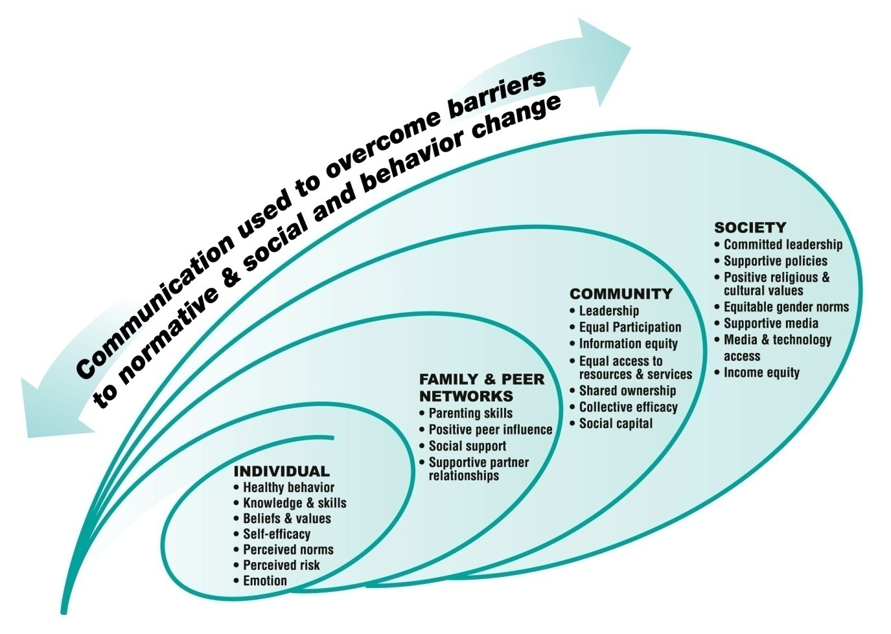
Socio-Ecological Model

Slide 4
8 C’s for Effective Communication
Command Attention
Clear and Concise
Consistent
Communicate a Benefit
Culturally Appropriate
Cater to Heart and Head
Create Trust
Call to Action
Notes:
These are guiding principles – but also how we evaluate our products to see if they’re quality or not.

Slide 5
Command Attention of the audience
Notes:
Lots of noise out there (competing interests, packed media environment, people are busy with other things) and we need to do something to get people to pay attention.

Slide 6
“The only thing worse than being talked about is not being talked about.”
-Oscar Wilde
Notes:
Especially in today’s media environment where getting attention is hard.

Slide 7

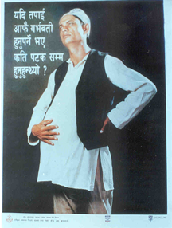

Slide 8
Keep the message content
Clear and Concise

Slide 9
Keep
It
Short
Simple
(3-4 New points in a 27 minute radio program)
Notes:
And knowing your audience - how much can they remember? If someone tells you 10 things how many will you remember?

Slide 10
FOCUS
DEMANDS
SACRAFICE
Notes:
If you get into this business, you will say this a lot.

Slide 11
“I apologize for the length of this letter, but I didn’t have the time to write a short one.”
- Mark Twain
Notes:
Is it easier to write two pages on topic or one paragraph. Much harder to keep it short.

Slide 12
Keep the message
Consistent
Notes:
Consistent repetition of the message helps audiences understand new ideas, learn how to perform a new behavior, and rehearse mentally how they might act.
Every element of the program (words, sound, characters,) should support a central theme or key idea.

Slide 13

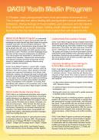




Notes:
All the information is reinforced by the DAGU radio program

Slide 14

Consistent with the radio program content

Slide 15
Communicate a Benefit
Notes:
Why should anyone care?

Slide 16
“In the factory we make cosmetics: In the store we sell hope.”
-Charles Revson
Founder of Revlon
Cosmetics

Slide 18
KNOW your “audience”
RESPECT your “audience”
COMMUNICATE to your “audience” in a manner appropriate to their culture, values.

Slide 19
Cater to Heart and Head
Better to appeal to the audience’s emotions,
intellect, or both?
Emotional appeal often more convincing than facts
Notes:
Audiences become personally and emotionally involved with role-models, characters, and situations with which they can relate.
They come to see the characters as real people whom they can trust and rely upon and want to be like.

Slide 20
Create Trust
Does information come from a credible source? Who is credible for the target audience?
  Medical doctor
  Ministry of Health
  Neighbors/friends/peers
  Celebrity
Notes:
Audiences become personally and emotionally involved with role-models, characters, and situations with which they can relate.
They come to see the characters as real people whom they can trust and rely upon.

Slide 21
Create a
Call to Action
Notes:
Strive to create messages that motivate the audience to adopt new attitudes or behaviors.
Powerful messages can inspire a person to advocate that attitude or behavior to their families and friends.

Slide 22



Slide 23
C’s for Effective Communication
Command Attention
Clear and Concise
Consistent
Communicate a Benefit
Culturally Appropriate
Cater to Heart and Head
Create Trust
Call to Action
Notes:
These are guiding principles – but also how we evaluate our products to see if they’re quality or not.

