Slide 1
Class 2-A
Riding the A TRAIN for Entertainment-Education Program Creation
Notes:
NOTE FOR INSTRUCTOR:
Explanations for all aspects of this presentation are in the homework/reading from Class 1 from the Esta deFossard/Riber book.

Slide 2
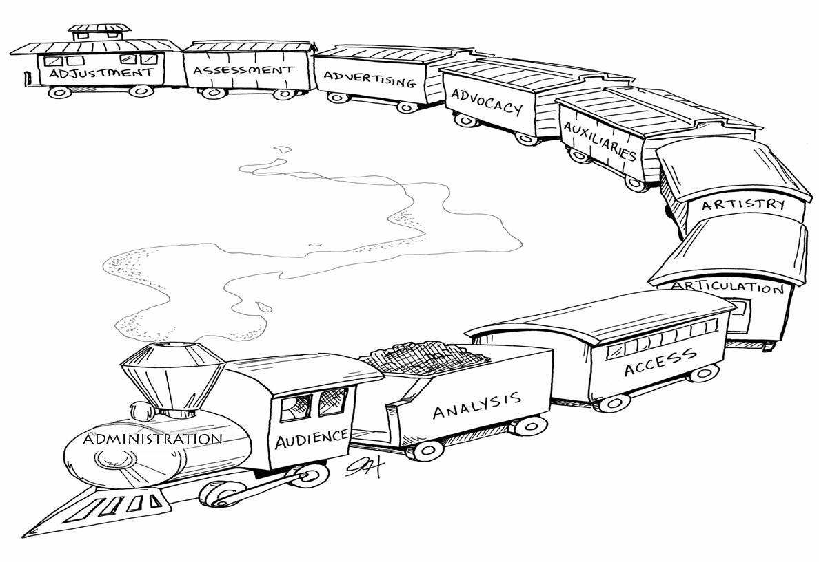
The “A” Train for
Entertainment-Education

Slide 3
1. Audience
The journey begins with a thorough understanding of the audience (s).
Notes:
We need to put ourselves in our audience’s shoes and see things from their point of view.
Often the manager thinks they know but they are educated and urban and often don’t. They may not understand the rural audience or youth or men. This can be compensated through research, frequent visits bad learning to appreciate their lifestyle and needs. This must be an attitude that all staff have.
Examples – why important to have audience participation in the process. Ie. Youth at workshops or rural FCHVs at Nepal workshops. (note special preparation must always be made to ensure that audience participants are comfortable, parental permission, translators (if there will be English spoken) maybe only on certain days and lots of positive attention towards them about the fact that they are valuable ‘experts’ (and they are – youth in ethiopia adding topics on ‘girl responsibilities at home’

Slide 4
The “A” Train for
Entertainment-Education

Slide 5
2. Analysis
The fuel for the train is a complete analysis of the problem:
The causes
The desired changes
Possible constraints to the changes
Most likely change motivators
Notes:
We often start at a large issue and need to figure out where communication fits in to help with the problem and what communication can help overcome.– Like ‘reducing maternal mortality in Nepal’.

Slide 6
The “A” Train for
Entertainment-Education

Slide 7
3. Access
A determination of what will be needed for the project and what is locally accessible: personnel; media outlets; trainers, etc. What training will be needed?

Slide 8
The “A” Train for
Entertainment-Education

Slide 9
4. Articulation
Determination and precise wording of the knowledge to be offered: The Design Process.

Slide 10
The “A” Train for
Entertainment-Education

Slide 11
5. Artistry
Writing and Production: Writers; reviewers; producers; editors; artists.

Slide 12
The “A” Train for
Entertainment-Education

Slide 13
6.Auxiliaries
Support Materials
Audience Groups

Slide 14
The “A” Train for
Entertainment-Education

Slide 15
7. Advocacy
Recruiting needed support from government, community, etc.
Encouraging audience to spread the word.

Slide 16
The “A” Train for
Entertainment-Education

Slide 17
8. Advertising
Promotion
Publicity
Prizes
etc

Slide 18
The “A” Train for
Entertainment-Education

Slide 19
9. Assesment
Pilot testing
Monitoring and Evaluation
Continuous throughout the project.

Slide 20
The “A” Train for
Entertainment-Education

Slide 21
10. Adjustment
Lessons learned and where to go from here.

Slide 22
Accomplishment!
PROJECT SUCCESS!

