Slide 1
Class 1
What is Entertainment- Education?
History, Definitions and Impact.

Slide 2
Definition
“Purposeful use of entertainment media …designed to educate viewers about certain social issues.”
William J. Brown and Arvind Singhal, 1999
Notes:
While there are several definitions of the EE, the most commonly used definitions are broadly around how Brown and Sighal have defined the term.

Slide 3
Definition
“Purposeful use of entertainment media …designed to educate viewers about certain social issues.”
  Intentional
  Links theory and evidence
William J. Brown and Arvind Singhal, 1999
Notes:
Two crucial factors, as per this definition, makes an entertainment product an EE. One, if the educational element is purposeful and the design of the product is based social and behavior change communication theory and evidence.

Slide 4
Origin of EE in Different Media
Medium | Year | Producer | Program | Area
Radio | 1951 | BBC | The Archers, UK | Promote agriculture innovations among farmers
Television | 1975 | Televisión Independiente de México | Ven Conmigo Come with me, Mexico | Adult education
Music | 1986 | Johns Hopkins University | Cuando Estemos Juntos (When we are together), Mexico | Abstinence and contraception
Film | 1986 | John Riber, Media for Development Trust (MFD) | Sonamoni"" (Golden Pearl) | Clean drinking water
Notes:
Is entertainment Education a new approach? No. Entertainment education has been used in different media starting at different times. It has been used in theater and music perhaps since the beginning of time through stories, texts and songs. The approach was incorporated into radio in the early part of the 1900s. And into TV and film closer to the 1950s (which will be the focus of this presentation.) More recently, the approach is being incorporated into video games and social media. As people’s media habits change, the entertainment education approach is adapted to the media channel.
Some of the documented pioneering products of EE in different media are listed in this table.

Slide 5
Three key moments
Social Learning Theory, 1960 - 1963
Simplemente Maria, 1969 - 1971
Miguel Sabido, 1975 - 1982
Notes:
If we are to locate the origin and history of EE, there are three key moments.

Slide 6
Social Learning Theory, 1960 - 1963
Albert Bandura, 1925 -
Behaviorism versus Cognitivisim
Imitation and Modeling
  Attention
  Retention
  Reproduction
  Motivation
Notes:
The first key moment is the introduction of the Social Learning Theory in 1963 by Albert Bandura based on his experiments with children on how modeling violence effects their behaviors. When Bandura introduced his theory in 1963, it was revolutionary at the time as it negated the established Behaviorism in psychology and instigated the cognitivism in science. The theory is roughly based on people imitate what they observe around them. For the model to be able to inculcate imitation if those who are observing it are attentive of what they see, and they are able to retain what they have observed, also they have the means to reproduce the same behavior. Finally, they need to be motivated of imitating the behavior of the model they observe.

Slide 7
Social Learning Theory, 1963
https://www.youtube.com/watch?v=zerCK0lRjp8
Notes:
Here is a BBC documentary introducing the Social Learning Theory and the impact it had on the science.

Slide 8
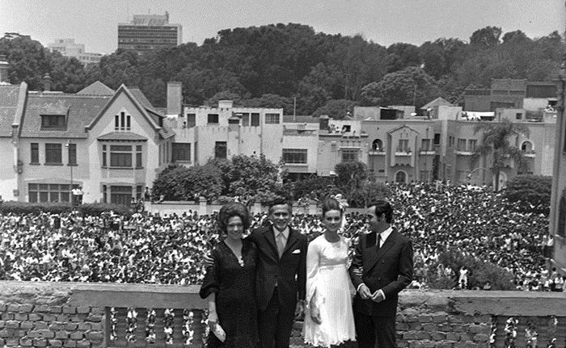
Simplemente Maria, 1969 - 1971
Notes:
This is an example of
Broadcast in black-and-white over 21 months between April 1969 and January 1971 in Peru, contained 448 episodes of one hour each.
Maria is an illiterate peasant girl who travels to the capital in search of a better life. Roberto is the prosperous urbanite who impregnates her, balks at marriage, then drops her. Esteban teaches her to read and write, giving her an opportunity to take a job as a seamstress. Maria uses her skills to establish a profitable dress shop of her own as her son Tony grows up. When he is a young man, he falls in love with his cousin Ita. The union is opposed by both families, and Ita goes into hiding in the provinces when she becomes pregnant. Her condition prompts the divided families to give their blessings to the wedding. Maria feels the empty nest syndrome when Tony leaves home, but she soon learns the patient and virtuous Esteban has loved her for all these years.
Over the course of the show there were ‘unintended consequences’ there was a dramatic rise in sewing, rise in adult literacy, rise in consideration of maids. (ATIF – WHAT DOES THIS MEAN?)

Slide 9
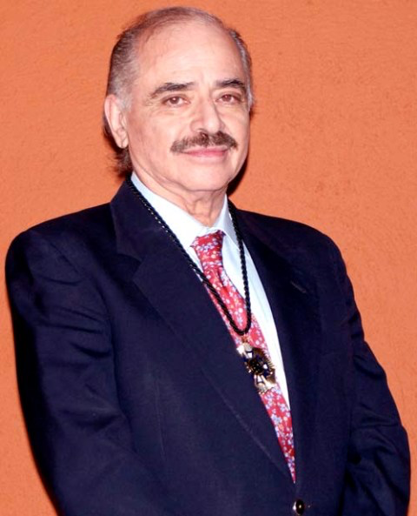
Miguel Sabido, 1975 - 1982
Entertainment-Education
  Integrated multidisciplinary theoretical framework
  Qualities of a commercial soap opera
Seven telenovelas
Notes:
Miguel Sabido was inspired by the impact of the Simplemente Maria as well as the social learning theory. He sought to understand how Simplemente Maria was so powerful and incorporated social learning theory in order to be able to design TV shows that would have impact on people’s behaviors.

Slide 10
Miguel Sabido
Ven Conmigo (Come With Me) encouraged 840,000 adults to enroll in adult literacy in 1975-76
Acompáñame (Come Along With Me) encouraged 562,464 Mexicans to visit government family planning clinics and registration of over 2,500 Mexican women as voluntary family planning workers in 1977
Notes:
Using the ‘Sabido Methodology’, he developed and broadcast two successful TV shows in Mexico that changed behavior and social norms.

Slide 11
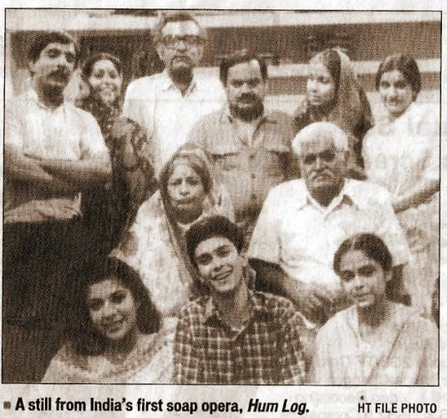
Entertainment Education in Subcontinent
First ever soap opera in India
Hum Log, 1984-1985
156 episodes
Women empowerment
Had the largest television audience at the time
94% considered the program entertaining
Received letters from 400,000 viewers
Notes:
After his initial success, he was inspired to move to India to develop Hum Log…
A content analysis of the Hum Log series indicated it addressed many of the important social issues confronting Indian society: family harmony, women's status, moral development, national integration, family planning, health, urbanization, and national welfare programs. About 50 million people watched the average Hum Log episode, which at the time (1984-85) was the largest television audience for any program. A survey of 1170 viewers indicated that 94% considered the program entertaining, 91% felt it addressed important social problems, and 83% found it educational. Although the initial episodes focused on family planning, pressures from audiences, sponsors, and the Indian Parliament forced producers to dilute the family planning theme and emphasize closely related themes such as women's status, family harmony, and family welfare. This shows that the educational content of soap operas cannot be too blatant or hard-sell. During the 17 months its broadcast, Hum Log received letters from 400,000 viewers, most of which confirmed the pro-social impact of the program. Hum Log's commercial success further led to a proliferation of domestically produced television serials and a decreased reliance on imported programming.

Slide 12
Hum Log, 1984 - 1985
https://www.youtube.com/watch?v=DKjXsB0YUjo

Slide 13
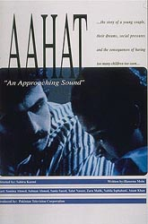
Aahat, Approaching Sound
Six-episode mini serial
October 1991
Family planning
Written by Haseena Moin
Directed by Sahira Kazmi
Notes:
Pakistan also developed another important Entertainment Education TV show called Aahat. A reading bout the impact of Aahat is a part of the course.

Slide 14
Meaning of EE
Entertainment: holds the attention of the audience, engages emotion and stimulates senses
Education: encourages and enables a person to develop and grow; enriches, enhances our knowledge and our life
Notes:
EE is not a theory it is a strategy
As the class to discuss the difference between Entertainment and Entertainment-education
What’s the proper balance? 70-30? 80-20?

Slide 15
Entertainment - Education
Often uses stories
Uses drama, music, or other communication formats that engage the emotions to inform audiences and change attitudes, behavior, and social norms.
Presents role models who can show the audience how to adopt healthy behaviors.
Commercially viable, where possible
Notes:
In Nepal, the ‘Aama’ or mother radio program about maternal and newborn health (linked with community action) inspired communities to set up transport and savings funds for emergencies, community dialogue about improved service provision and supported groundswell of support for MNH policy in the new constitution.

Slide 16
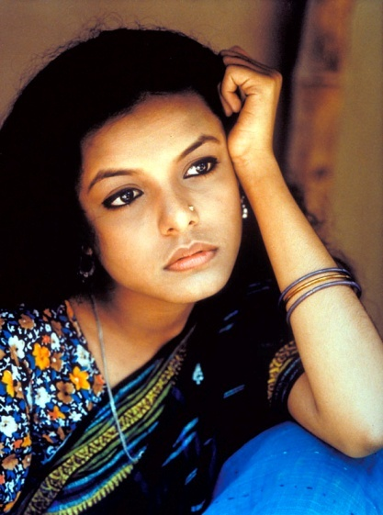
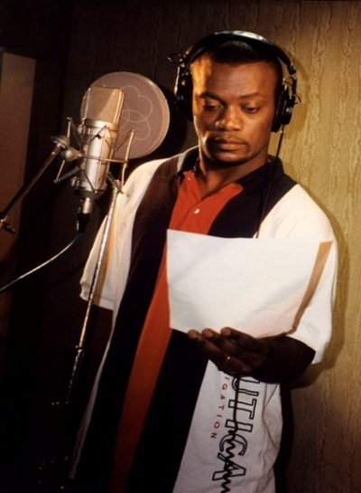
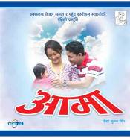
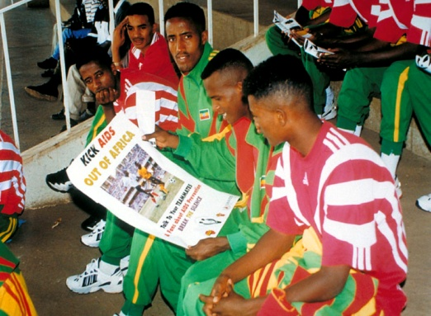
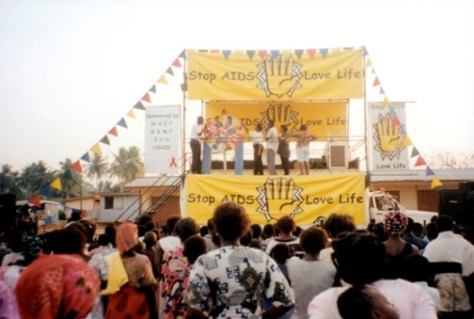
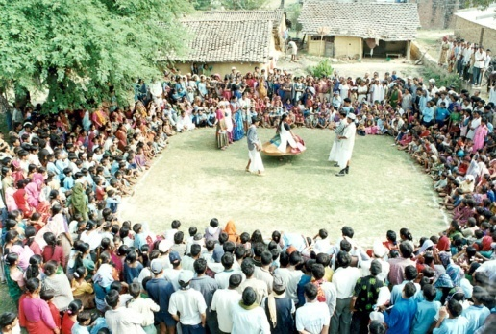
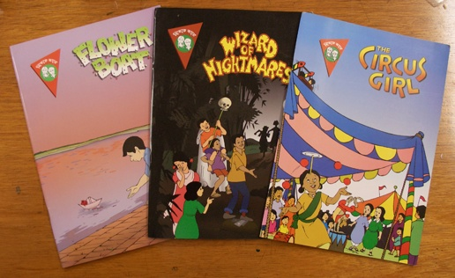

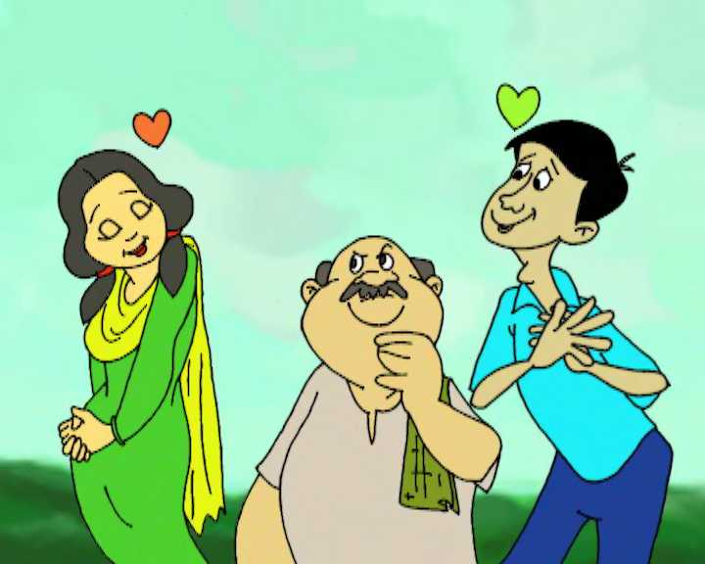
The power of Entertainment-education
Animation
Songs
Sports
TV dramas
Radio
serials
Community events
Street theater
https://www.dropbox.com/s/ngicsnd2pbclks1/Final%20with%20Intro-Logo-H.264%20800Kbps%20Streaming.mov
Comic Books
Children’s TV
Notes:
There are many EE issues and formats. If you click on the link at the bottom, should get a video that shows a number of examples.
US – based EE incorporated into existing media - like a Harvard Alcohol Project that incorporated episodes of 75 television programs in the 80s.
For more on how to incorporate entertainment education messages or modeling into existing popular programs can check out the Hollywood health and society. https://hollywoodhealthandsociety.org/

Slide 17
Formats
Drama Serial – “Soap Operas” Radio drama programs that have a story that continues takes place over a number of different episodes or chapters.
Drama Series – a program where key characters, settings are the same across different episodes but each episode is a complete story.
Notes:
Serial Drama - The Wire, Soap operas,
Series Examples - Seinfeld, ER

Slide 18
More formats
Magazine Comprise a number of segments or formats, which hosts weave together into a single presentation.
      ExampIe: songs, dramas, vox-pop, reality segments, expert interviews, call-in, quizzes, etc.
Reality Programming
Often in form of testimonials. Popular but has challenges.
Notes:
The “magazine” format allows the educational content to be repeated in several segments of a single program.

Slide 19
Challenges of EE
Perceived as costly (though actually cost effective)
Difficult to show some sensitive topics
Hard to measure
Getting the entertainment and education balance right
A quality program is challenging to make
Making routine interesting

Slide 20
Case Study 1: Aahat National Campaign
(1990-92): 6-episode social drama, 3 TV spots, print IEC materials.

Slide 21
Aahat Impact
2 National Media Surveys conducted (pre- and post campaign, Sample size 2,100)
60% of respondents viewed at least 1 episode (3/4 of those with access to TV)
17-20 million people in Pakistan viewed at least 1 episode; 93% of viewers were satisfied to very satisfied
Approval for FP rose from 65%(pre) to 75% (post) among viewers

Slide 22
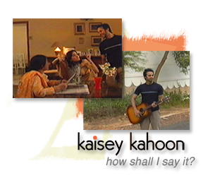
Case Study 2:
TV Drama for youth
11 episode (one hour per episode) serial drama titled Kaisey Kahoon (How Shall I Say It?)

Slide 23
Objectives
An enabling environment for healthy reproductive health and family planning (RH/FP) attitudes and behaviors.
create youth demand for young adult RH/FP services
encourage young people to discuss life issues with adults.

Slide 24
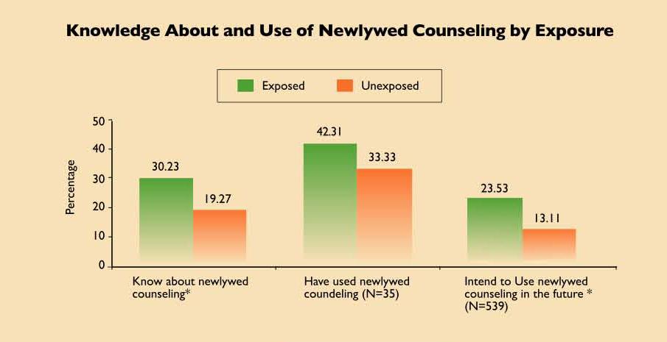
Notes:
People who watched the show were more likely to know about and used newlywed counseling.

Slide 25

CASE STUDY 3:Using Entertainment-Education to change MNCH in Pakistan
PAIMAN (Promise) - TV Drama Series
Notes:
Shifting norms requires showing new norms by characters and families others can recognize and associate with.

Slide 26
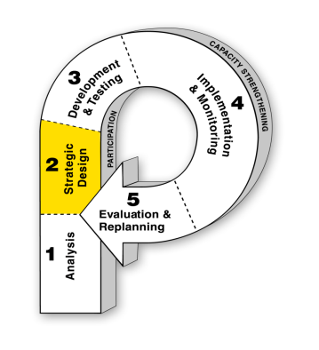
Paiman Goals
Goal
Ensure safe pregnancy and delivery through collective efforts of households and communities by shifting norms and motivating supportive MNCH behaviors from influencers
Promote pregnancy as a special time requiring proper care
Promote proactive informed MNCH attitudes
Encourage birth preparedness among family members
Increase knowledge about danger signs
Promote husbands as caring role models
Objectives
Notes:
Shifting norms requires showing new norms by characters and families others can recognize and associate with.

Slide 27
Reach & Likeability
Household surveys
1894 women
630 husbands
630 mothers-in-law
PAIMAN Project Behavior Change Communication (BCC) Evaluation Report, 2009
Notes:
Based on household surveys conducted with over 1800 women of reproductive age, and 640 husbands and Mothers in law, in Sukkur, Jaffarabad, and Rawalpindi. One in three people had seen the drama and those that saw it liked it a lot, as much as regular TV.

Slide 28
Knowledge & Attitudes
Women exposed to TV drama compared with those not exposed reporting the importance of . . .
n = 3,154
*
*
*
*
*
Significant at .05 level
PAIMAN Project Behavior Change Communication (BCC) Evaluation Report, 2009
Notes:
Paiman TV show also had impact on attitudes. That is , that those watching it compared to those not watching were more likely to report the importance of key health behaviors related to maternal health such as Antenatal care, importance of hospital delivery and postpartum care (after birth of a child)

Slide 29

Behaviors

Slide 30
Case Study 4: Nigeria Nollywood Transmedia
Newman Street….
https://www.youtube.com/watch?v=wBorL6Xb7n415:56
(3:29 – 6:20)
2Face Music Video
https://www.youtube.com/watch?v=sI6ND_O96K0&feature=youtu.be
30
Notes:
Transmedia is a ‘new’ concept in Entertainment education for behavior and social change.
Transmedia is a process where popular characters a story are systematically spread across multiple media platforms: radio, television, videos, music, mobile applications, print materials, books, social media, games, and more. This approach engages audiences on more than one platform in the characters, their lives, conflicts, decisions, and evolution. It gets the characters and their stories out to people through their preferred media, and reinforces messages through multiple channels.
In this example of Newman Street from Nigeria, scenes (use the clip 3:29 – 6:20) from the show that feature key characters and moments in the drama are used in a popular music video to reinforce messages. In this case, the scene is to increase people’s risk perception that if they have child with a fever, it could kill a child from malaria if they don’t get tested and treatment.
30

Slide 31
Comparison of individuals exposed to Newman street and those not exposed (National)
Indicator | June 2016
 | Exposed | Not exposed | P-value
Proportion of people who know the main symptom of malaria | 78.1% | 78.1% | 0.990
Proportion of people who know there is a drug for IPTp | 59.6% | 43.6% | <0.001
Proportion of people who know the treatment of malaria | 28.8% | 28.9% | 0.975
Proportion of people who slept inside LLIN | 55.9% | 35.7% | <0.001

Slide 32
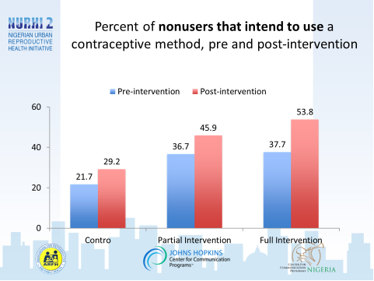
Notes:
Study to test the efficacy of the TV drama
Cluster-randomized control trial with with pre and post intervention survey data collection;
Control arm-126 respondents
Partial intervention arm-120 respondents
Full intervention arm- 117 respondents
Participants: Men and women, 18-49 years
Intervention conditions:
Control group - No intervention
Partial intervention group – 6 episodes over three weeks
Full intervention group – 12 episodes
Pre- and post intervention data collection conducted in July/August 2016
Sample size: 369 respondents followed up pre-post
Socio-demographic characteristics;
Contraceptive awareness;
Perceived self-efficacy to take contraceptive-related actions;
Myths and rumors about family planning;
Current contraceptive use and intention;
Contraceptive method preferences
Opinions about the episodes watched

